Slide 1

Comparison of geostatistical methods for spatial data
Sevvandi Kandanaarachchi, Spencer Wong, Jennifer Flegg, Nick Golding
AASC 2022

Slide 2
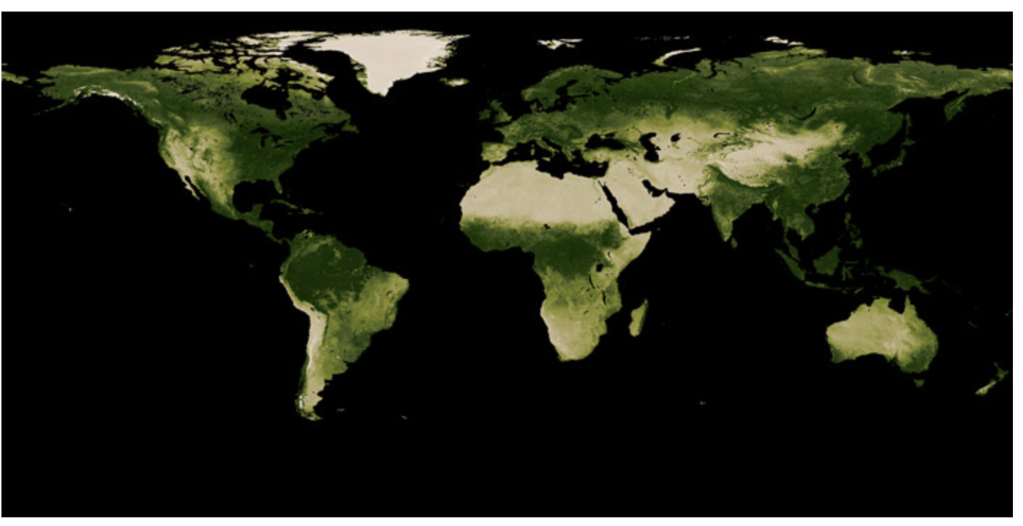
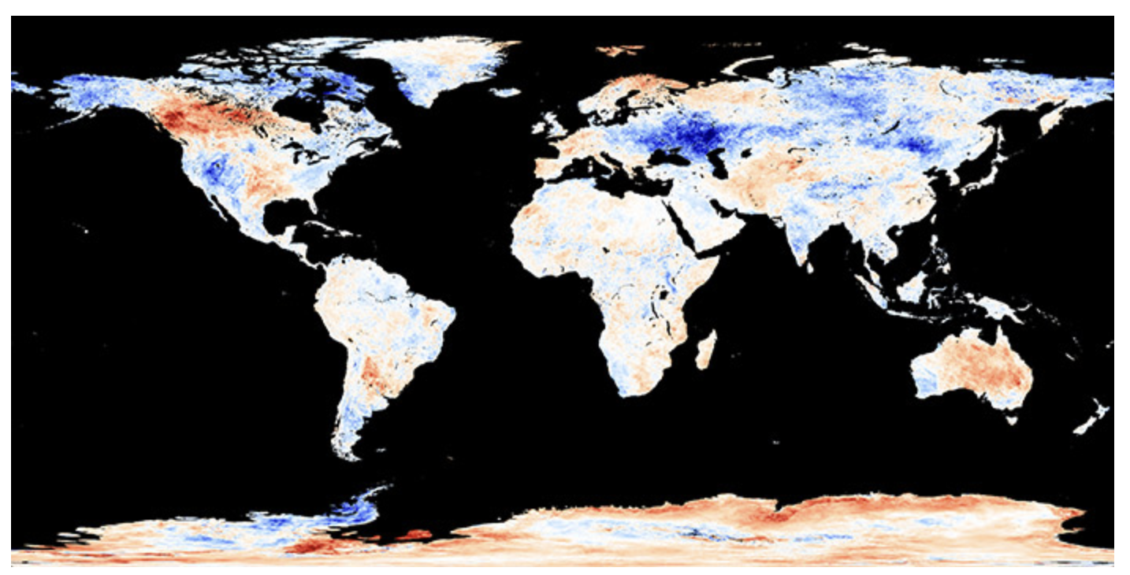
Geospatial data is everywhere
Climate
Disease
Energy
Satellite data
Vegetation Index (NASA)
Vegetation Index (NASA)
Land surface temperature anomalies(NASA)
Land surface temperature anomaly (NASA)

Slide 3
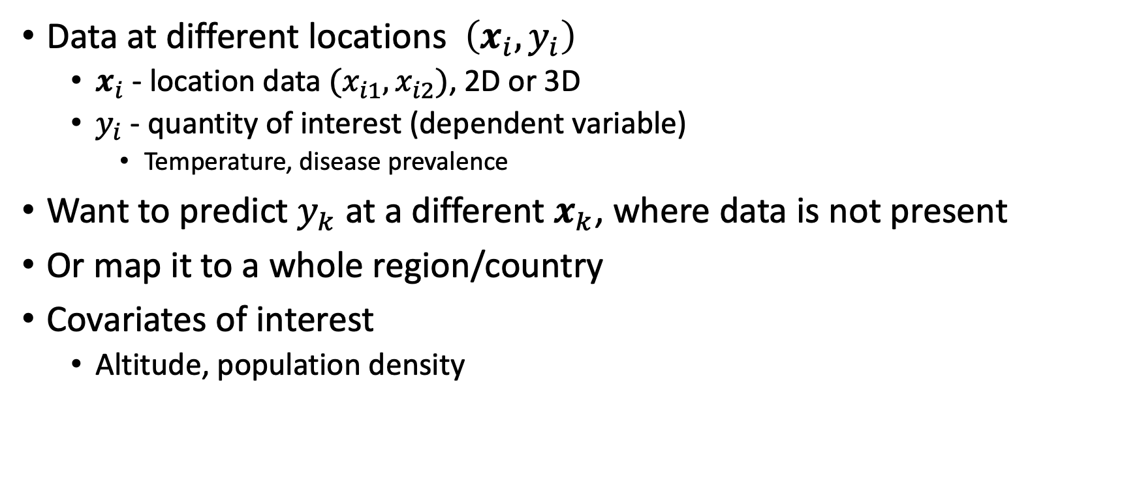
The original problem
Data at different locations $\left(x_{i}, y_{i}\right)$
$x_{i}$ - location data ${(x}_{i1}, x_{i2})$, 2D or 3D
$y_{i}$ - quantity of interest (dependent variable)
Temperature, disease prevalence
Want to predict $y_{k}$ at a different $x_{k}$, where data is not present
Or map it to a whole region/country
Covariates of interest
Altitude, population density

Slide 4
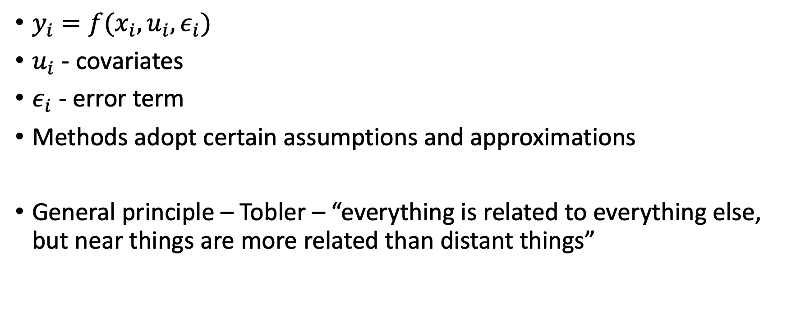
The original problem
$y_{i}=f(x_{i},u_{i}, ε_{i})$
$u_{i}$ - covariates
$ε_{i}$ - error term
Methods adopt certain assumptions and approximations
General principle – Tobler – “everything is related to everything else, but near things are more related than distant things”

Slide 5
Methods we compare
INLA – Integrated Nested Laplace Approximations
SpRF – Spatial Random Forests
FRK – Fixed Rank Kriging
GPBoost – Tree boosting with Gaussian Processes
Standard parameters for all methods

Slide 6
Computation
Data – latitude, longitude, number of people tested, number of people positive
Prevalence = number positive/number tested
Kenya data in 2009
10 and 50-fold CV
Map of Kenya
Africa
Africa maps

Slide 7
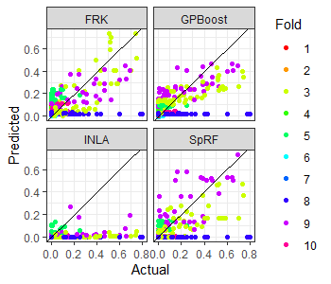
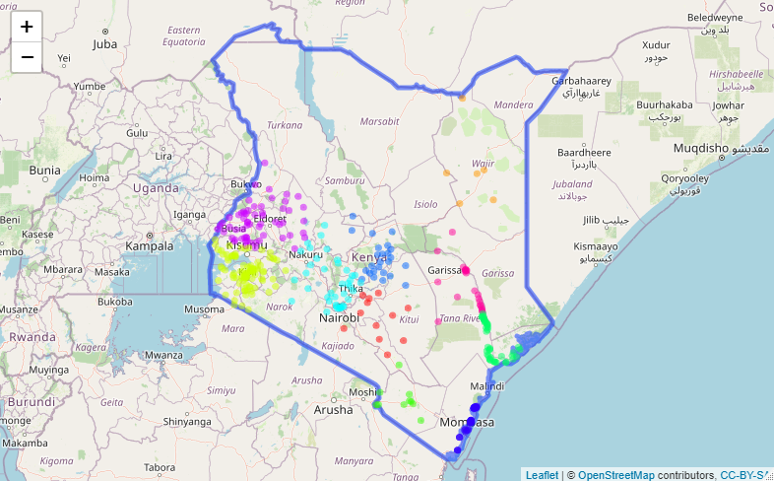
10-fold CV

Slide 8
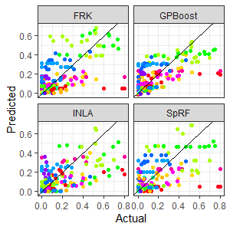
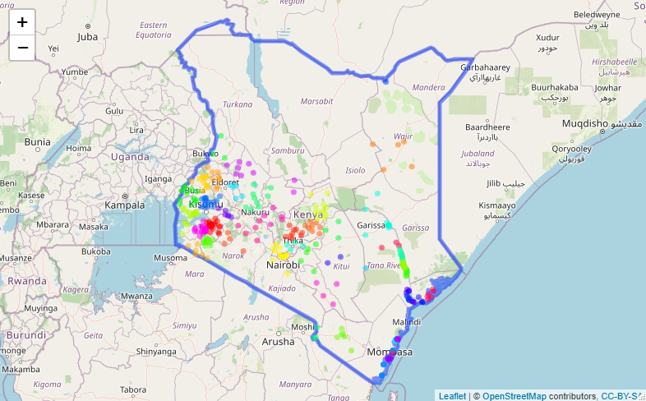
50-fold CV

Slide 9
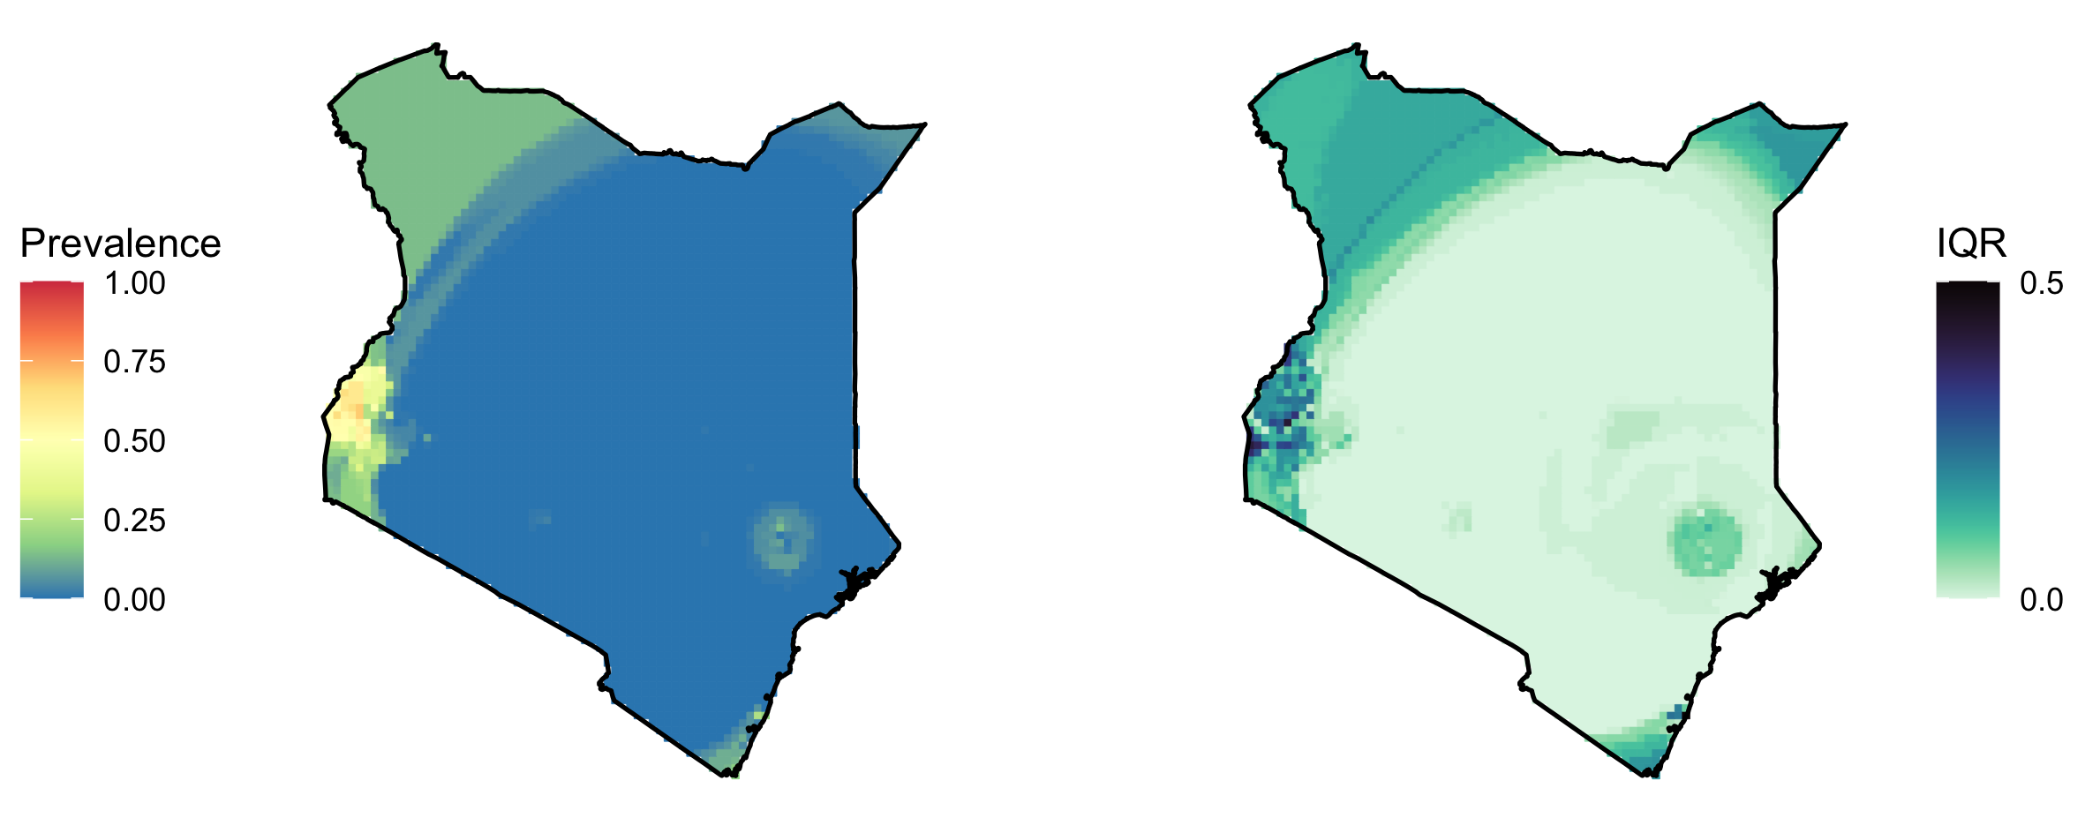
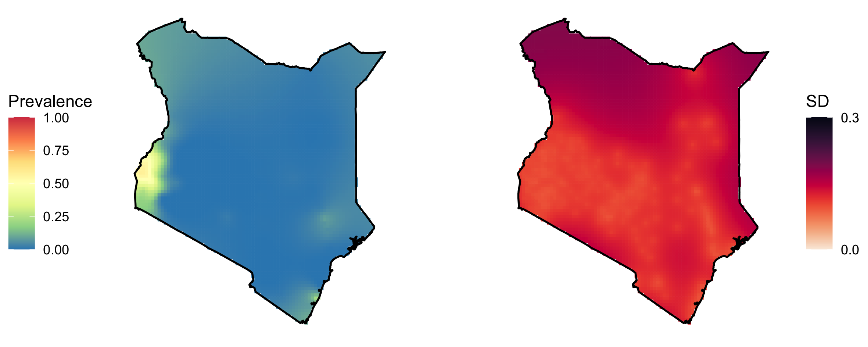
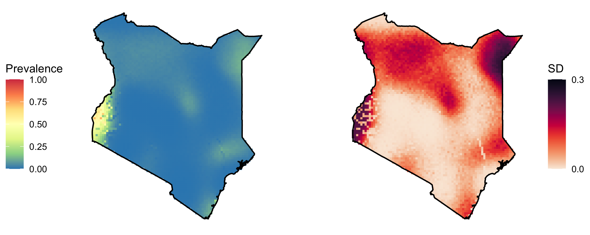
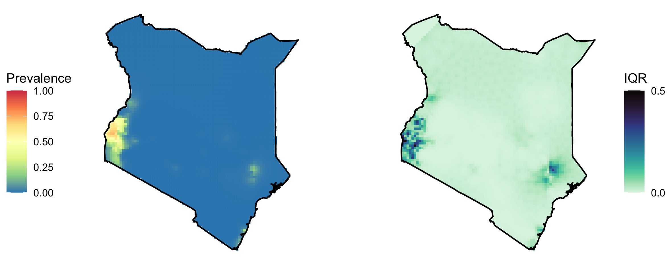
SpRF
GPBoost
FRK
INLA

Slide 10
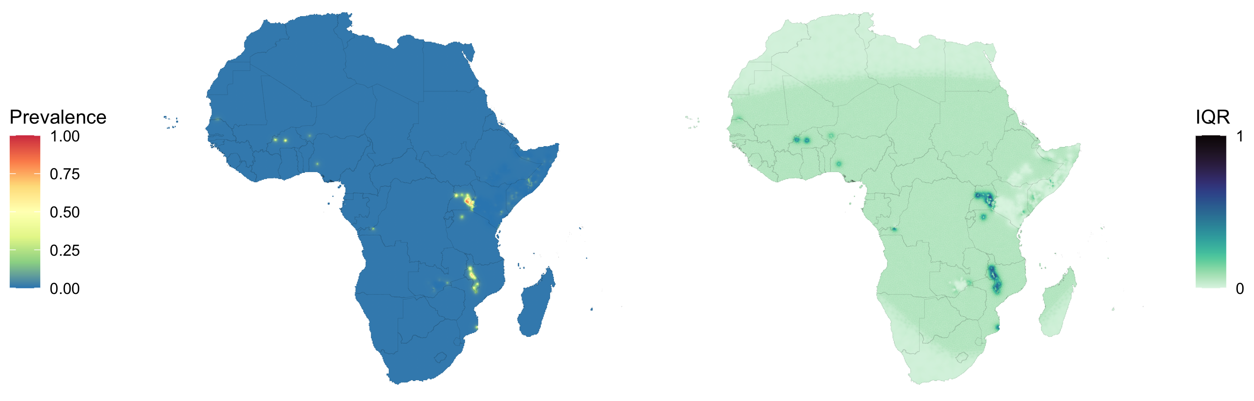
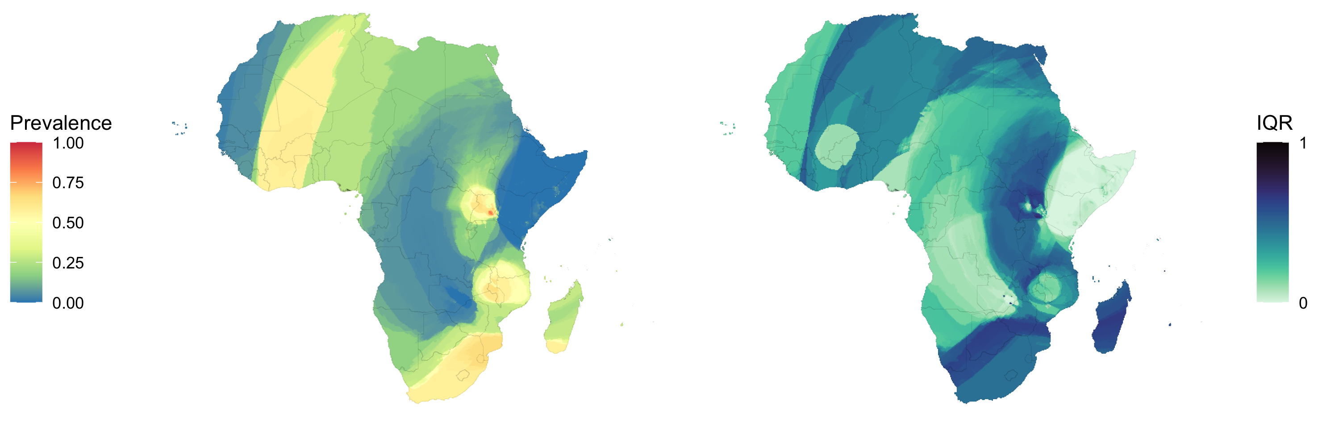
Africa
INLA
SpRF

Slide 11
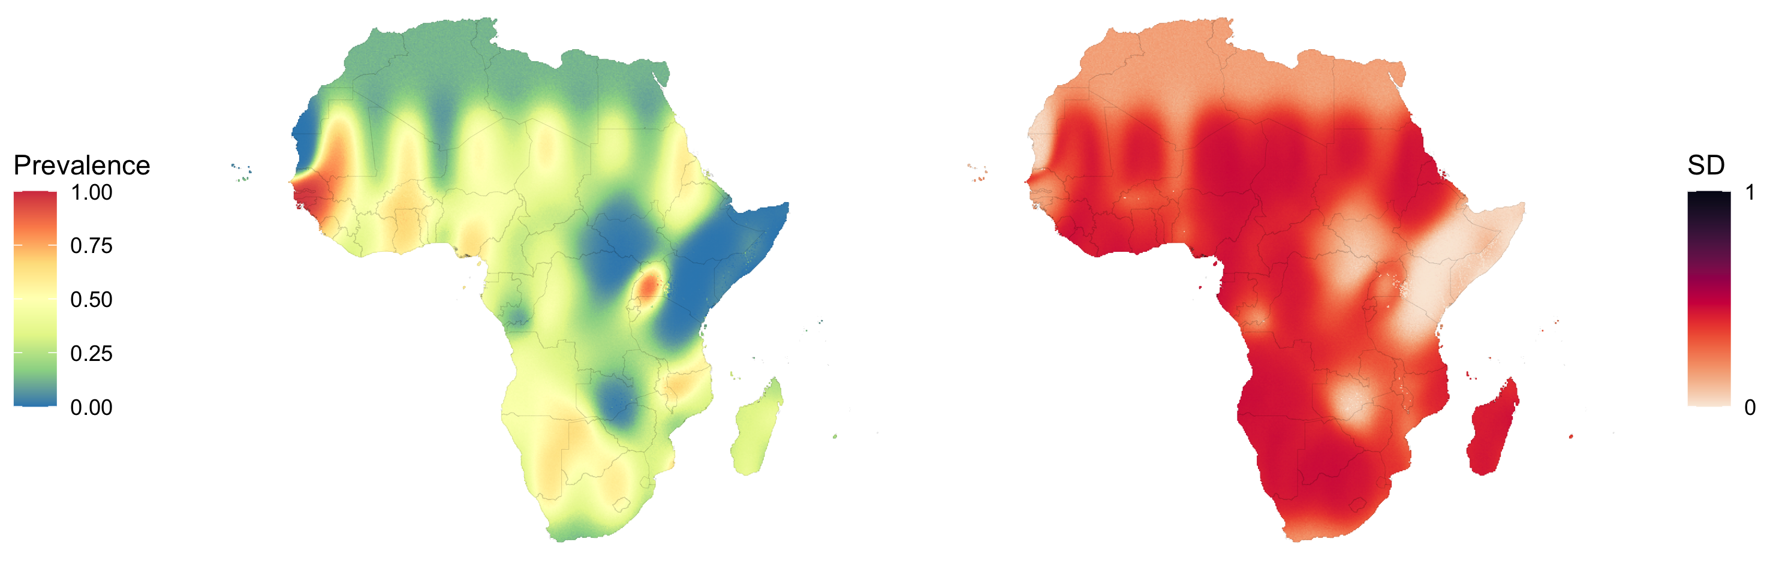
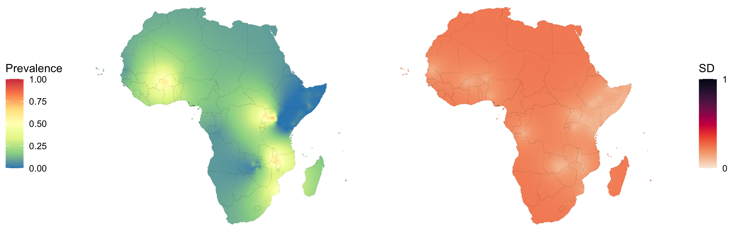
FRK
GPBoost

Slide 12
Reflections
Maps get a bit messier when we model Africa
Need to tune the parameters
Sparsity of points
See the artefacts of the methods more when you go for bigger scales
For bigger scale maps – users need to understand the methods more
Not off the shelf– at this point for bigger regions!

Slide 13
Thank you!
Questions?

